Slide 1
Parent Guide to Using Lexile Scores Provided on the Georgia Milestones Individual Score Reports
Using the Lexile Score to support the growth of your child’s literacy skills

Slide 2
Georgia Milestones- Lexile Scores and Stretch Bands
The Georgia Department of Education has worked with MetaMetrics®, the developers of The Lexile® Framework for Reading, to establish the relationship of the Georgia Milestones English Language Arts (ELA) assessments and the Lexile scale. Meta Metrics has been providing Lexile scores across the world for over 20 years.
The Lexile measure is based on the reading portion of the ELA test

Slide 3
What is a Lexile measure?
Indicates the level of book that a student can read with 75% comprehension
Offers a student a certain amount of comfort while still providing challenge
This is their “Instructional” level- a level that is not too difficult, but will challenge them appropriately.

Slide 4
How are Lexiles calculated?
Semantic Difficulty
Word Frequency (Count word frequency, word difficulty)
Syntactic Complexity
Sentence Length (Complexity of sentence structure)

Slide 5
Individual Score Reports- Ga. Milestone Lexile Measure and Lexile Range
Lexile Range please note:-- 100 points lower– to 50 points higher.
This would be the targeted text- instructional band for achieving the most growth with a student.
Notes:
The GAMS were Lexile leveled based upon specific reading questions located in all 3 areas of the ELA test. The student’s performance based upon their interaction with the test
on all 3 sections, on specifically identified reading questions, determined their Lexile measure.

Slide 6
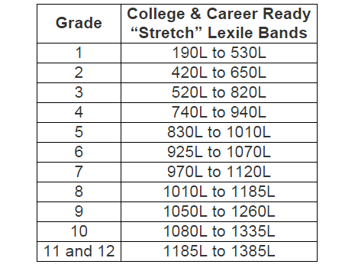
It is recommended that students independently read within a text band of 100 points below their Lexile, and up to 50 points above their Lexile.
Example:
If your child has a
Lexile of 970. Their band would be approximately from 870 to 1020. If the text Lexile is higher, your child may need additional support.
The complete range of Lexiles starts from below OL up to 2000L
Notes:
If students are scoring in the 740- 940 Lexile band or below in the 8th grade, they will need very strategic and intensive reading instruction focusing upon the 5 pillars of reading (phonics,phonemic awareness, vocabulary, comprehension, fluency). A diagnostic reading plan.

Slide 7
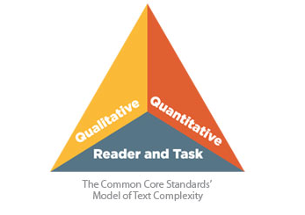
Lexiles are only ONE component of analyzing text for our children.
It is equally important to consider age, content, background knowledge, maturity and interests of child.
levels of meaning
structure
language conventions
clarity of language
knowledge demands
appropriateness
Lexile
word frequency
sentence length
Knowledge, motivation, interests ,attitudes, maturity
Notes:
Notes: The Common Core Model of Text Complexity asks teachers to consider the “Purpose” for using the text. Teachers must consider all three pieces of the model before choosing
Text for their students.

Slide 8
How do Lexiles help teachers?
Adjusting materials to the purpose of reading
Differentiating texts
Differentiating access to texts
Building classroom libraries
Building reading lists

Slide 9
How do Lexile’s help parents?
Will help parents:
Help their child choose books- But please remember… reading doesn’t always have to be within their range. Books that are highly motivational, engaging and age appropriate are equally as important. LOVE of reading is KEY!!! If Lexile is higher, adult support is recommended (read together, discuss).
Improve communication between home/school/library regarding their child’s reading needs and accomplishments.
Celebrate student reading gains and accomplishments.
Finding the right book for you! Locate titles.
https://www.lexile.com/fab/

Slide 10
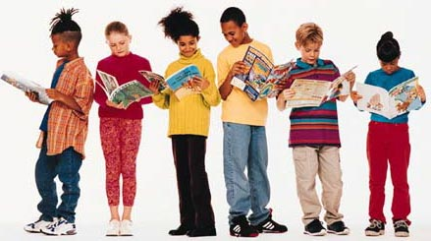
Parents Can Help Support Literacy Growth
Encourage your child to read often, and for their own interests. We must instill within our children a love and need for reading.
Model the importance of reading, by reading in front of your child and discussing how reading helps you in your daily life.
Know your child’s Lexile level. Don’t focus entirely on the level, but also make sure the text is appropriate (age, content, language, and engaging for your child). If you would like to increase your child’s literacy level, remain within their Lexile stretch band. If the Lexile of the chosen text is higher, please read, discuss, and support your child through the reading of the text.

Slide 11
Resources
Find A Book (Find books at a variety of Lexile levels)
Destiny—Lexile measures (School Librarian)
Miller, D. (2014) Reading in the Wild
Georgia DOE: Lexile Framework for Reading
Lexile Framework for Reading (One-Pager)
Lexile Informational Video
Literacy in History/Social Studies, Science, and Technical Subjects

Slide 12
Please contact us if you have any further questions.
Classroom teacher (Content specific)
Counselors-
6th grade ssabo@forsyth.k12.ga.us
7th grade mmalcolm@forsyth.k12.ga.us
8th grade vrawlins@forsyth.k12.ga.us
Media Center Assistant ltafuto@forsyth.k12.ga.us
Administrator
kogline@forsyth.k12.ga.us
Thank you!
Together we will help our children grow to their full potential!

